Slide 1
Enhancement Care Management
Quality Improvement Program
(ECM QIP)
2022 ECM QIP Kick-Off Webinar
Robert Moore, MD MPH MPA, Chief Medical Officer
Amy McCune, Manager of Quality Improvement Programs
Deanna Watson, QIP Project Manager
March 10, 2022
Notes:
DEANNA:
Hi Everyone, and thank you for joining us today.
On behalf of our QIP Team, I’d like to thank the CalAIM ECM Team for allowing us to host this webinar during today’s roundtable.

Slide 2


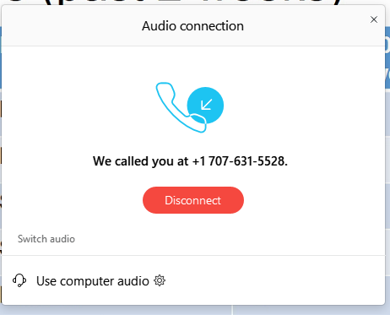
Webinar – Audio Instructions
To avoid echoes and feedback, we request that you use the telephone audio instead of your computer audio for listening and speaking during the webinar.
Figure 1
Click Switch Audio
You can switch your audio connection by clicking on the three dot ellipsis icon found at the bottom of your screen.
Figure 2
Enter telephone number
Notes:
DEANNA:
To avoid echoes and feedback, we request that you use the telephone audio instead of your computer audio.
At the bottom center of the Webex screen, you will see a row of buttons.
1) Locate and click on the ellipsis icon (Figure 1) and select “Switch Audio”
2) Then select the Call Me or Call In option (Figure 2).

Slide 3
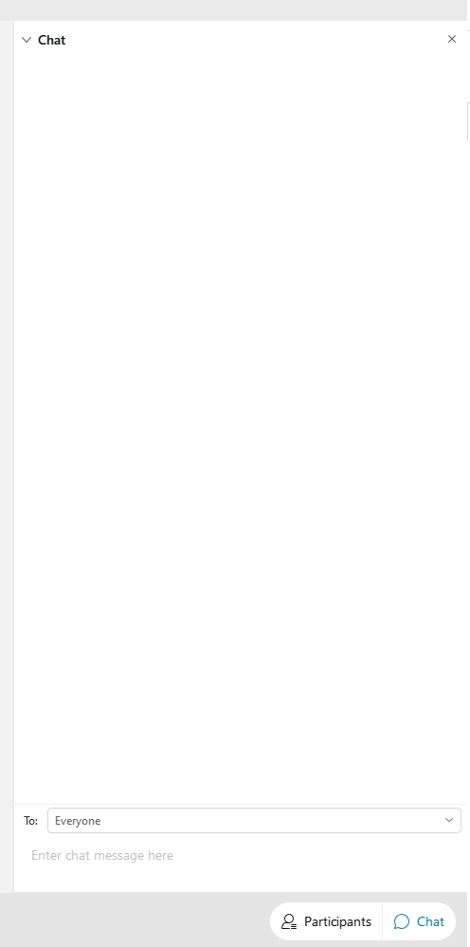

Webinar Information
Figure 1
  This webinar will be recorded.
  All attendees have been muted to eliminate any possible noise/ interference/distraction.
Please take a moment and open your chat box by clicking the chat icon found at the bottom right-hand corner of your screen and as shown in Figure 1.
If you have any questions, please type your questions into the chat box, and they will be answered at the end of the presentation.
Be sure to select “Everyone” when sending a message.
Notes:
DEANNA:
I would like to advise you that this webinar is being recorded - and the PowerPoint and recording will be available on our ECM QIP webpage in the next week or so.
All attendees have been muted to eliminate any possible noise interference or distraction.
Feel free to use your chat box to type questions or comments any time during the webinar, by clicking on the chat icon found in the lower right-hand corner of your screen (as shown in Figure 1).
While we encourage you to ask questions, time has been put aside at the end of the webinar to answer questions.
Be sure to select Everyone when sending messages.

Slide 4
Agenda
About Us
ECM Benefit Overview
Guiding Principles
ECM Quality Improvement Program
Contact Us
Q & A
1
2
3
4
5
6
Notes:
DEANNA:
We understand most of you are already familiar with the ECM background; however, for others who are new participants, this may be new information.
So, with that said, we will go over the first 3 sections, About Us and Guiding Principles as well as ECM Benefit overview & Reporting, understanding that this will be a review for regular participants.
To start us off, I’m honored to introduce Dr. Robert Moore, our Chief Medical Officer at Partnership.

Slide 5
1
About Us
Notes:
DR. MOORE

Slide 6
2
Guiding Principles
The ECM QIP adheres to the (3) guiding principles of the DHCS CalAIM program:
Identify and manage member risk and need through whole person care approaches and addressing Social Determinants of Health.
Move Medi-Cal to a more consistent and seamless system by reducing complexity and increasing flexibility.
Improve quality outcomes, reduce health disparities, and drive delivery system transformation and innovation through value-based initiatives, modernization of systems and payment reform.
NOTE: In 2023, ECM QIP will evolve and will carry its own guiding principles associated with a pay-for-performance program.
Notes:
DR. MOORE

Slide 7

ECM Benefit Overview
3
Notes:
DEANNA:

Slide 8
ECM Benefit Overview
Definition
Enhanced Care Management (ECM) benefit is part of the California Advancing and Innovating Medi-Cal (CalAIM) initiative.
Medi-Cal benefit that replaces current Whole Person Care (WPC) pilot and Intensive Outpatient Care Management (IOPCM) activities.
CalAIM is a multi-year initiative, organized by the Department of Health Care Services (DHCS) to address the multifaceted challenges facing California’s most vulnerable residents.
Objective
To motivate, modify, and improve health outcomes of (7) identified groups of individuals by standardizing a set of care management services and interventions, and then building upon the positive outcomes from those programs.
Notes:
DEANNA:
As mentioned before, this may new information for some of you and a review for others.
The Enhanced Care Management (ECM) benefit is part of………………………….
The objective of the ECM Benefit is to……………………..

Slide 9
ECM Benefit Overview
2022 Go-Live Schedule
Phase I: January 1, 2022 | Phase II: July 1, 2022 | Phase III: January 1, 2023 | Phase IV: July 1, 2023
Marin Napa Mendocino Shasta Sonoma | Solano Trinity Lake Siskiyou Yolo Modoc Humboldt Lassen Del Norte | All 14 Counties | All 14 Counties
Notes:
DEANNA:
This is the Go-Live Schedule which is in 4 phases – Phases I and 2 in 2022, and phases 3 & 4 in 2023.

Slide 10
ECM Benefit Overview
Identifying Groups: 1 & 2
Phases I & II
a) Adult individuals who are experiencing homelessness (as defined by HUD)
AND
b) who have at least one complex physical, behavioral, or developmental
health need with inability to successfully self-manage, for whom coordination
of services would likely result in improved health outcomes and decreased
utilization of high high-cost services.
Phases I & II
Adult High Utilizer individuals:
a) who have 6 or more emergency room visits in a 12-month period
OR
b) who have 2 or more unplanned hospital and/or short-term skilled nursing
facility stay in a 12-month period
1
2
Notes:
DEANNA:

Slide 11
ECM Benefit Overview
Identifying Groups: 3
Phases I & II
Adult individuals with SMH or SUD:
who meet with eligibility criteria for participating in the County Specialty Mental Health (SMH) Plans and/or the Drug Medi-Cal Organization Delivery System (DMC-ODS)
AND
who are actively experiencing at least (1) complex social factor influencing their health
AND
who meet (1) or more criteria as follows:
  at high risk for institutionalization, overdose and/or suicide;
  use crisis services, emergency rooms, urgent care or inpatient stays as the sole source of care;
  experienced two or more ED visits or two or more hospitalizations due to SMI or SUD in the past 12 months; or
  pregnant or post-partum women (12 months from delivery).
3
Notes:
DEANNA:

Slide 12
ECM Benefit Overview
Identifying Groups: 4 – 7
4
Phase III
Individuals at risk for institutionalization who are eligible for long-term services.
Nursing facility residents who want to transition to the community.
Individuals transitioning from incarceration within the last 12 months who have significant complex physical and behavioral health needs requiring immediate transition of services to the community
Children or youth with complex physical, behavioral or developmental health needs (ex: CCS, foster care, youth with Clinical Risk
Syndrome, or first episode of psychosis)
5
Phase III
6
Phase III
7
Phase IV
Notes:
DEANNA:

Slide 13
ECM Reporting
4

Slide 14
ECM Reporting
Report 1: ECM Provider Return Transmission File (RTF)
MY 2022 ECM QIP Reporting Timeline
Report Name / Submission Pathway / Naming Convention | Reporting Schedule / Due Dates | Responsible Party / Submission Template Link
Report Name: ECM Provider Return Transmission File (RTF) Submission Pathway: sFTP Naming Convention: Facility Name_RTF_Date | 2nd Friday of the month: 02/11/2022; 03/11/2022; 04/08/2022; 05/13/2022; 06/10/2022; 07/08/2022; 08/12/2022; 09/09/2022; 10/14/2022; 11/11/2022; 12/9/2022 | Provider (File sent via sFTP Folders) Link to Submission Template Provider Return Transmission File (RTF)
Email report to ECM/CalAIM Team: ECM@partnershiphp.org (NOTE: You do not need to email this report to the ECM QIP Team)
Notes:
DEANNA:
Let me confirm here that all reports will continue to be sent to the ECM/CalAIM team.

Slide 15
ECM Reporting
Report 2: ECM Provider Initial Outreach Tracker File (IOT)
MY 2022 ECM QIP Reporting Timeline
Report Name / Submission Pathway / Naming Convention | Reporting Schedule / Due Dates | Responsible Party / Submission Template Link
Report Name: ECM Provider Initial Outreach Tracker File (IOT) Submission Pathway: sFTP Naming Convention: Facility Name_IOT_Date | 2nd Friday of the month: 02/11/2022; 03/11/2022; 04/08/2022; 05/13/2022; 06/10/2022; 07/08/2022; 08/12/2022; 09/09/2022; 10/14/2022; 11/11/2022; 12/9/2022 | Provider (File sent via sFTP Folders) Link to Submission Template Provider Initial Outreach Tracker File (IOT)
Email report to ECM/CalAIM Team: ECM@partnershiphp.org (NOTE: You do not need to email this report to the ECM QIP Team)

Slide 16
ECM Reporting
Report 3: ECM Provider Capacity Survey
MY 2022 ECM QIP Reporting Timeline
Report Name / Submission Pathway / Naming Convention | Reporting Schedule / Due Dates | Responsible Party / Submission Template Link
Report Name: Provider Capacity Survey Submission Pathway: Google Docs | 4th Tuesday of the month: 02/22/2022; 03/22/2022; 04/26/2022; 05/24/2022; 06/28/2022; 07/26/2022; 08/23/2022; 09/27/2022; 10/25/2022; 11/22/2022; 12/27/2022 | Provider (Survey sent via Google Forms)
Email report to ECM/CalAIM Team: ECM@partnershiphp.org (NOTE: You do not need to email this report to the ECM QIP Team)

Slide 17
ECM QIP
5
Enhanced Care Management Quality Improvement Program
Notes:
DEANNA:
Now we will go over the ECM Quality Improvement Program

Slide 18
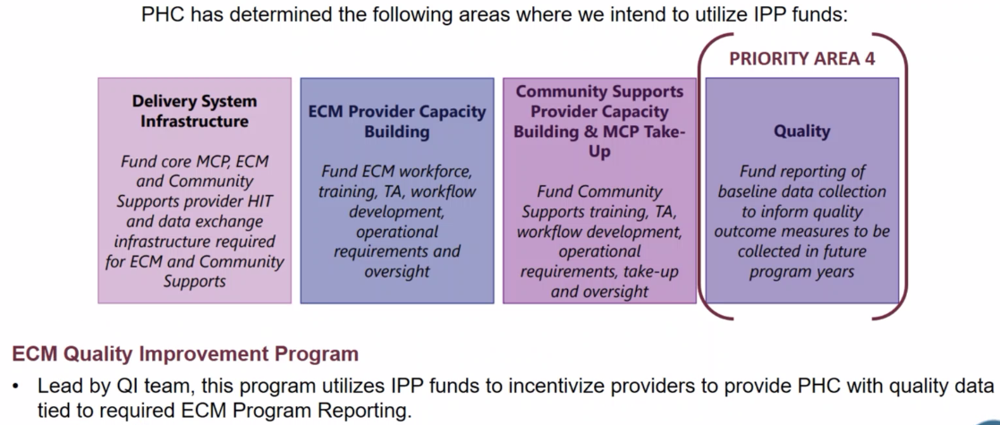
ECM QIP Background
ECM
QIP
Notes:
DEANNA:
These are the 4 priority areas where PHC intends to utilize IPP funds, and Priority 4 is where the ECM QIP comes to light.

Slide 19
ECM QIP Defined
What is ECM QIP?
PHC’s Enhanced Care Management Quality Improvement Program (ECM QIP) is an extension of CalAIM ECM initiatives.
Using IPP funds, ECM QIP participants are incentivized for providing timely reporting.
PHC has expertise in pay-for-performance programs through other QIP’s for primary care, hospitals, perinatal, long-term, and palliative care.
Notes:
DEANNA:

Slide 20
ECM QIP Future Changes
2022
Calendar year: January 1 - December 31, 2022
Pay-for-reporting only program
2023 & Beyond
Expansion to pay-for-performance program
Other grant programs coming soon
Notes:
DEANNA:

Slide 21
2022 ECM QIP Timeline
2022 Measurement Period:
January 1, 2022 – December 31, 2022
2023
Jan 2022 | Feb 2022 | Mar 2022 | Apr 2022 | May 2022 | Jun 2022 | Jul 2022 | Aug 2022 | Sep 2022 | Oct 2022 | Nov 2022 | Dec 2022
Jan 2023 | Feb 2023
1st Quarter
QIP Payment
5.31.22
2nd Quarter
QIP Payment
8.31.22
3rd Quarter
QIP Payment
11.30.22
4th Quarter
QIP Payment
2.28.23
2022 Payment Summary
Reporting Periods | Payment Month
January 2022 - March 2022 | May 2022
April 2022 - June 2022 | August 2022
July 2022 - September 2022 | November 2022
October 2022 - December 2022 | February 2023
Notes:
DEANNA:
This is our 2022 timeline.
Incentive payments will be distributed quarterly with the last quarter’s payment being distributed in February of 2023.

Slide 22
ECM QIP Payment
Payment Methodology
Payment Rate: $100 per enrolled member per month
For every enrolled ECM member the ECM provider will receive $100 for submission of all required reports from that particular month.
Payment is based on timeliness of submission.
Payment Methodology
Submissions received with all 3 reporting requirements on or before due date – Paid at 100%
Submissions received up to 1 week or 5 business days past due date – Paid at 50%
Submissions not received within 5 business days are considered late – Paid at 0%
Reports more than 30 days overdue require a corrective action which can include separation from participation in the ECM program as a provider.
Example:
Provider has 50 enrolled ECM members and submits all 3 reports on or before the due date for all 3 months of the quarter.
Payment for the entire quarter would be $15,000, or $5,000 for each month.
NOTE: Enrollment may fluctuate from month to month which will impact the calculation.
Notes:
DEANNA:

Slide 23
Contact Us
6

Slide 24
Contact Us
ECM QIP Team
Amy McCune, Manager of Quality Improvement Programs
Deanna Watson, QIP Project Manager
ECM QIP Related Questions
Email: ECMQIP@Partnershiphp.org
ECM QIP Webpage
http://www.partnershiphp.org/Providers/Quality/Pages/ECM-QIP-Enhanced-Care-Management.aspx
ECM QIP Specifications
http://www.partnershiphp.org/Providers/Quality/Documents/QIP%202022/2022%20ECM%20QIP%20Program%20Specifications%20-%20Final%20-%202.22.22.pdf

Slide 25
Other Contacts
ECM Benefit & Reporting Questions?
Contact the ECM/CalAIM Team
Email: ECM@Partnershiphp.org
Collective Medical Questions?
Email: support@collectivemedical.com

Slide 26

Q & A
7
Questions?
Type your question
in the Chat Box

